Slide 1




Hands-on Workshop on Network Technologies
Hands-on session 1: Introduction and Basic Configuration
Lab 3 - IPv6 Lab Series
Jose Gomez¹, Jorge Crichigno²
¹Fort Lewis College (FLC)
²University of South Carolina (USC)
https://research.cec.sc.edu/cyberinfra/
Tuesday, Jul 21, 2026
Online

Slide 2
IPv6 Lab Series
Lab 1 Introduction to Mininet
Lab 2 Introduction to FRR
Lab 3 IPv6 Address Configuration
Lab 4 Enabling Stateless Address Autoconfiguration (SLAAC) in IPv6 Routers
Lab 5 Configuring Devices using SLAAC and Stateless DHCPv6 Server
Lab 6 Configuring Devices using Stateful DHCPv6
Lab 7 Using IPv6 Static Routing
Lab 8 Configuring Single Area OSPFv3 for IPv6
Lab 9 Using BGP in an IPv6 network
Lab 10 Configuring DNS and Web Servers in an IPv6 network
Lab 11 Transitioning from IPv4 to IPv6 – tunnels
Lab 12 Configuring Stateless NAT64
Lab 13 Enabling IPv4 and IPv6 Coexistence with DN64
Lab 14 Configuring IPSec Tunnel on IPv6
Lab 15 Monitoring IPv6 networks using Zeek

Slide 3
Other Lab Libraries
Cybersecurity
Virtual Labs on Cybersecurity Tools and Applications
Virtual Labs on Zeek Intrusion Detection and Prevention Systems

Slide 4
Other Lab Libraries
SDN and P4 Programmable Data Plane Switches
Cybersecurity Applications on P4 Programmable Data Planes
P4 Programmable Data Planes: Applications, Stateful Elements, and Custom Packet Processing
P4 Programmable Data Plane Switches based on BMv2
P4 Programmable Data Plane Switches based on Intel’s Tofino Chip
Introduction to Software Defined Networking (SDN)
Introduction to P4-DPDK

Slide 5
Other Lab Libraries
Routing and Switching
Open Shortest Path First (OSPF)
Introduction to Border Gateway Protocol (BGP)
MPLS and Advanced BGP Topics
Open vSwitch (OvS)

Slide 6
Other Lab Libraries
Network Monitoring and Management
Network Management Tools (Netflow, IPFix, sFlow)
Introduction to perfSONAR
PerfSONAR 5.0
P4-perfSONAR Lab Series

Slide 7
Other Lab Libraries
Network Fundamentals
Network Tools and Protocols (NTP)
Introduction to IPv6

Slide 8
Objectives of this Session
Understand the types of IPv6 addresses.
Differentiate between IPv6 Link Local Address (LLA) and Global Unicast Address (GUA).
Configure IPv6 LLA and GUA.

Slide 9
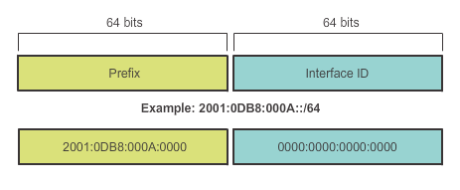
IPv6 Unicast Addresses
Global Unicast
  Similar to a public IPv4 address
  Globally unique
Link-local
  Used to communicate with other devices on the same local link
  Confined to a single link; not routable beyond the link

Slide 10
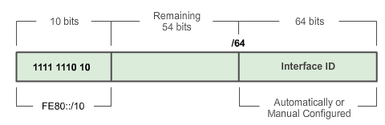
IPv6 Unicast Link Local Address
Every IPv6-enabled network interface must have a link-local address
It enables a device to communicate with other IPv6-enabled devices on the same link and only on that link (subnet)
FE80::/10 range, first 10 bits are 1111 1110 10xx xxxx
Notes:
1111 1110 1000 0000 (FE80) - 1111 1110 1011 1111 (FEBF)

Slide 11
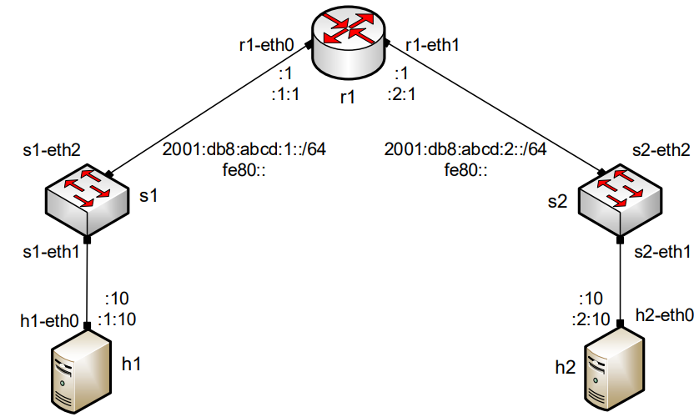
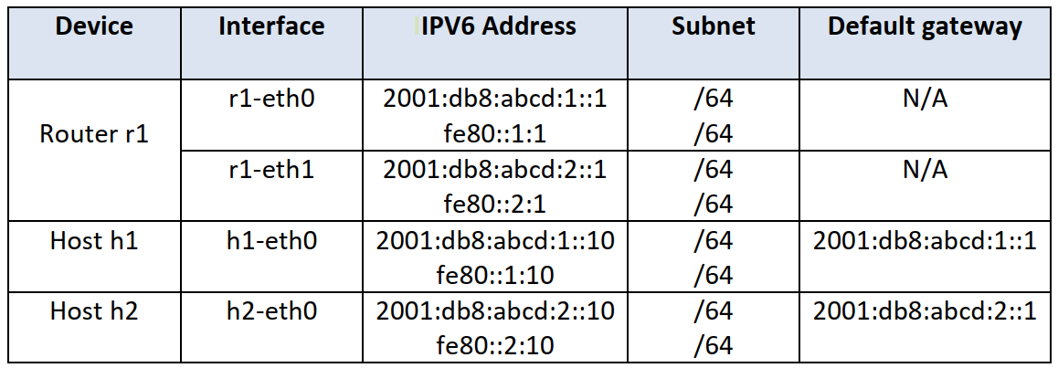
Network Topology
Lab 3
Network topology
Address information

Slide 12
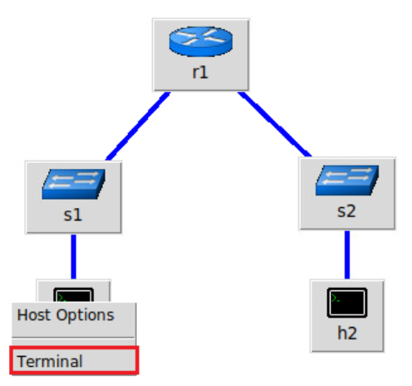
Network Topology
Lab 3
FRR router
Linux host
Linux host
Network topology
Mininet implementation

Slide 13
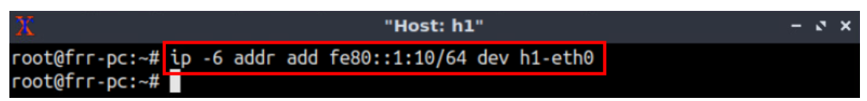
Network Topology
Lab 3
Network topology

Slide 14
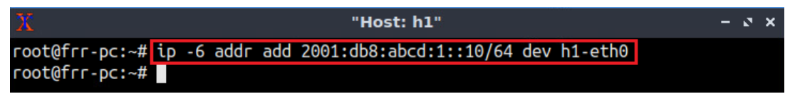
Network Topology
Lab 3
Network topology

Slide 15
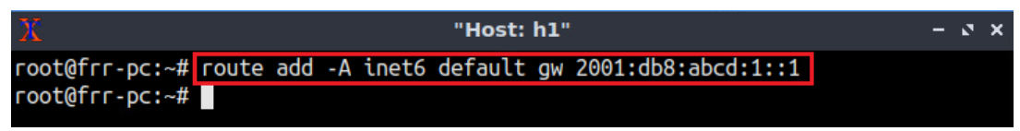
Network Topology
Lab 3
Network topology

Slide 16
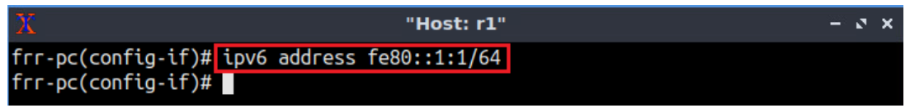
Network Topology
Lab 3
Network topology
Mininet implementation

Slide 17
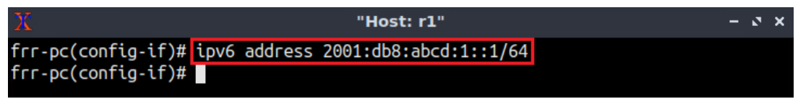
Network Topology
Lab 3
Network topology
Mininet implementation

Slide 18
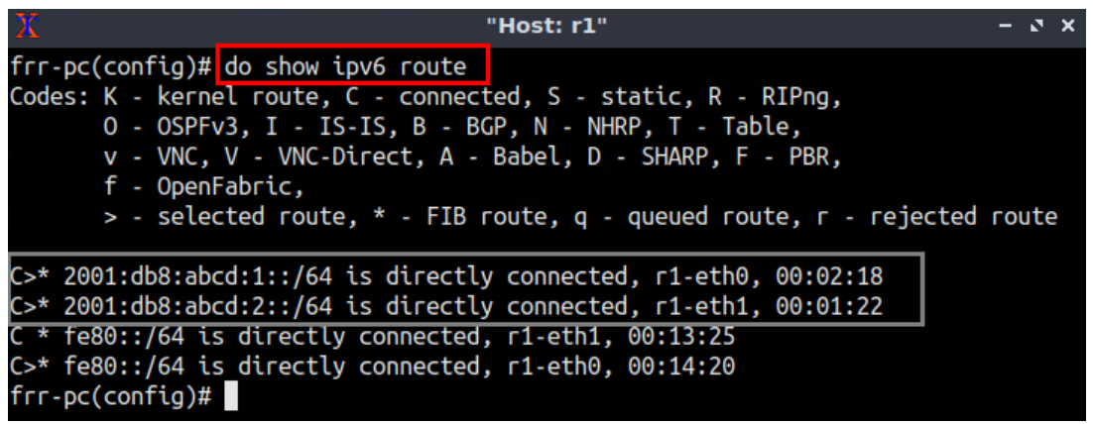
Network Topology
Lab 3
Network topology
Mininet implementation

Slide 19
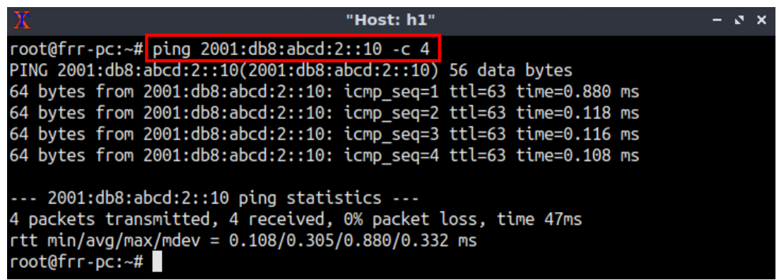
Network Topology
Lab 3
Network topology
Testing connectivity from host h1 to host h2

Slide 20
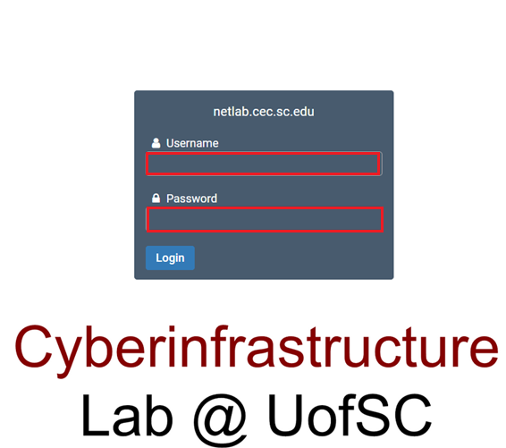
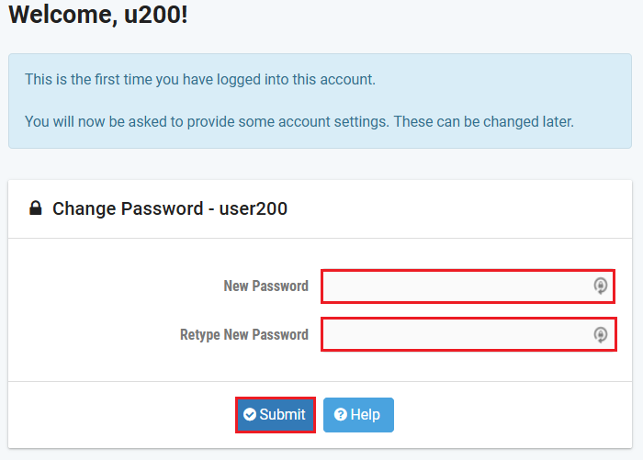
Accessing the Platform
Please use the following link to access the platform: https://netlab.cec.sc.edu/
Login using the following credentials:
Username: email used for registration
Temporary Password: nsf-2026

Slide 21
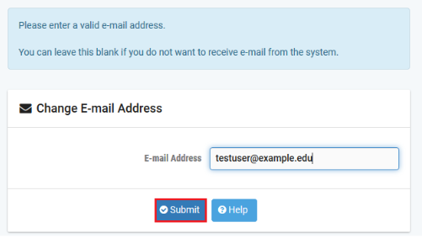
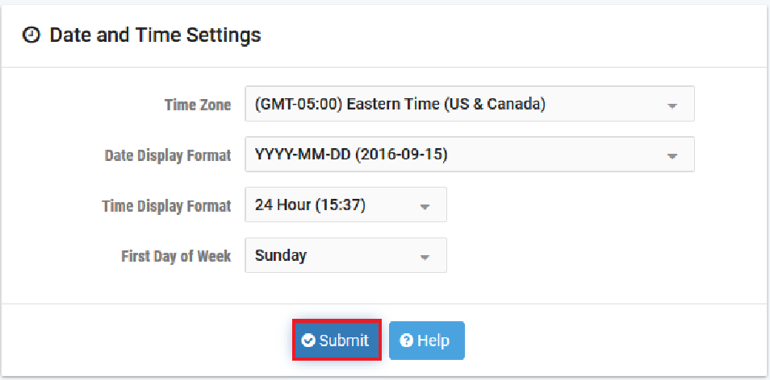
Accessing the Platform
Please use the following link to access the platform: https://netlab.cec.sc.edu/
Login using the following credentials:
Username: email used for registration
Temporary Password: nsf-2026

Slide 22
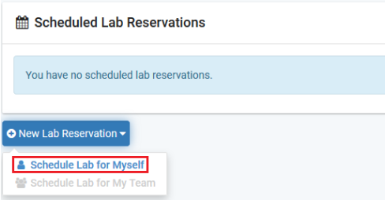
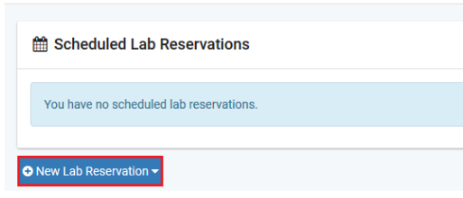
Accessing the Platform
Click on New Lab Reservation
Click on Schedule Lab for Myself

Slide 23
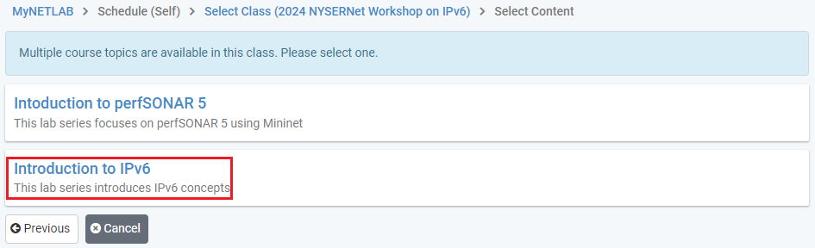
Accessing the Platform
Select the course
For this session, we will use “Introduction to IPv6”

Slide 24
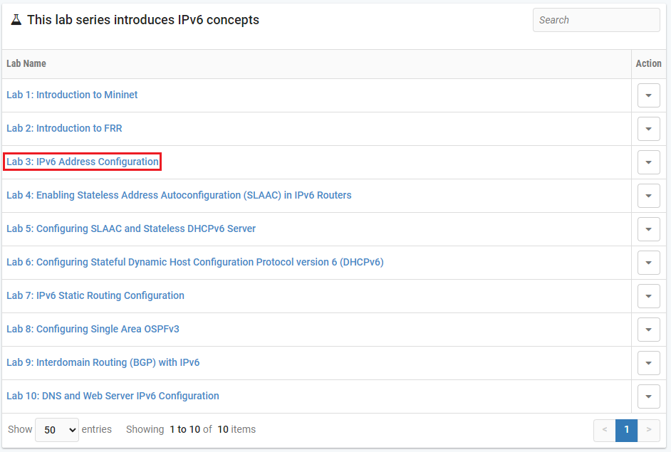
Accessing the Platform
Select the Lab
For this session, we will run:
  Lab 3: IPv6 Address Configuration

Slide 25
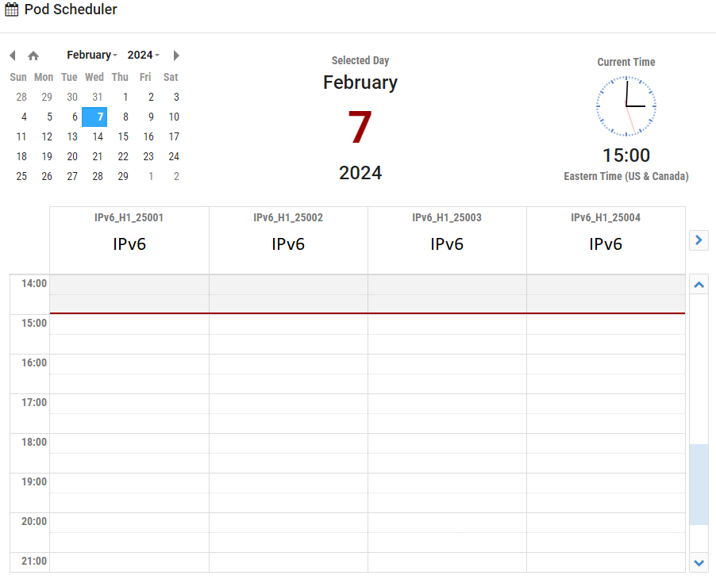
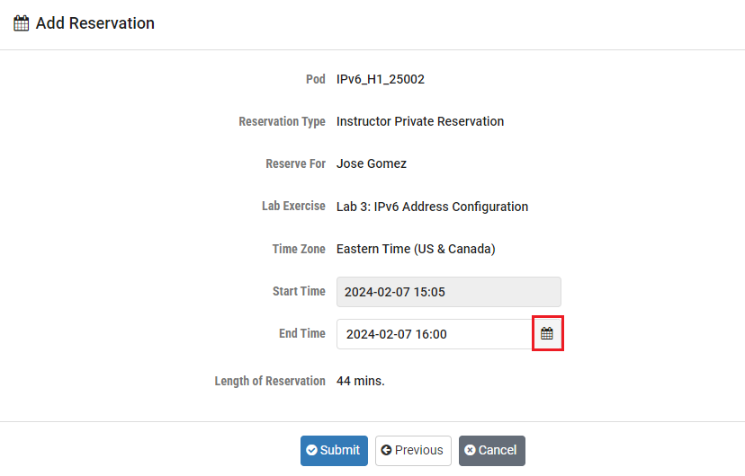
Accessing the Platform
Select the next available POD and allocate time

Slide 26
Accessing the Platform
We will use the NETLAB virtual platform:
URL: https://netlab.cec.sc.edu/
Username: email used for registration
Temporary Password: nsf-2026

Slide 27
Additional Slides

Slide 28
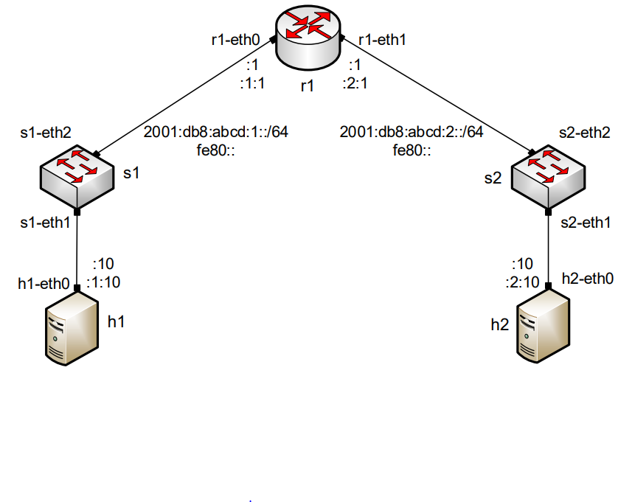
Network Topology
Lab 3

Slide 29
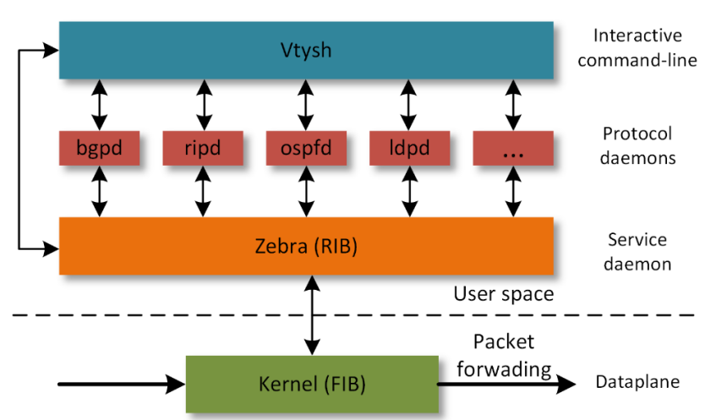
Free Range Routing (FRR) Architecture (Lab 2)

