Slide 1
IPv6 Workshop
Doug Southworth, dsouthworth@tacc.utexas.edu
Corey Eichelberger, ceichelberger@tacc.utexas.edu

Slide 2
Who are we?
Doug Southworth
20+ years in IT (K-12, government, R&E)
MSCE, Full stack dev, network guy - you name it
Currently at TACC as a network performance analyst/engineer
I know just enough to be dangerous about most IT subjects

Slide 3
Who are we?
Corey Eichelberger
~15 years working IT in R&E
Many different hats over the years
  Mostly Networking and Security
  Systems/Storage
  Other duties as assigned*
HPC
EPOC - Engagement and Performance Operations Center
*Disclaimer: I haven’t touched Windows since ~2013 and haven’t worked in a campus environment since 2016.

Slide 4
Thank you for having us!

Slide 5
IPv6 - Fundamentals
This discussion attempts to contain:
  Fundamentals that underpin IPv6
  Addressing nuances and subnet allocations

Slide 6
Fundamentals that underpin IPv6 - History
IPv6 adds to the most recent version of the Internet Protocol we all know and use ( the IP in TCP/IP )
IETF draft in 1998 to help solve the impending IPv4 exhaustion issues. ( Ratification in 2017 ).
M-21-07.pdf
page 3: “ By 2025 80% Federal networks must be IPv6 only! “

Slide 7
Fundamentals that underpin IPv6 - size
IPv6 addressing is beyond vast at 2^128 ( 340 undecillion ) addresses**
  340 undecillion - in the range of atoms in the entire earth.
  A job that paid 390 trillion dollars/hr: one would have to work 24 x 7 x 365 for about 100 quadrillion years to earn 340 undecillion dollars (same timeframe as comfortable retirement these days).
IPv4 is sitting at ~4.3 billion** addresses
Mandatory xkcd on IPv6
TL;DR - We will have to work very hard to exhaust IPv6!
** with some slack for special addresses etc…

Slide 8
Fundamentals that underpin IPv6 - implications
Few quick implications of all this delicious space:
  Keep a Full internet routing table(s)?
    IPv6 full tables eventually will be non-trivial.
  One /64 is a internet of internets!
    A single /64 subnet has 18,446,744,073,709,551,616 usable host addresses.
    There are “only” 4,294,967,296 IPv4 addresses**
    I have to count the commas…
  Planning and design just as important if not more.

Slide 9
Fundamentals that underpin IPv6 - implications
  Keep it easy on yourself keep the prefixes non-fragmented!
    BGP advertise as large of blocks as possible vs small ‘chunks’
  DNS
    Size of IPv6 space
      zone files can have ‘just a few’ entries… Hand curation for critical systems only.
  Security!
    One does not simply:
      nmap -T4 -F 2001:db8::/32
      Firewalls still let the packet hit the floor.

Slide 10
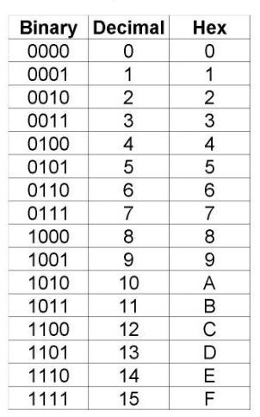
Fundamentals that underpin IPv6 - Hexadecimal

Slide 11
Fundamentals that underpin IPv6 - Addresses
Addressing fundamentals ( take a peek at RFC-5952 ):
Quick example of the same address ‘tuned’:
2001:0db8:0000:1000:0000:0000:00a0:0000
2001:db8:0:1000::a0:0
lower case is “highly” preferred - no need to shout your HEX
leading zeros can be clipped
:: is your friend but, can only be used once
browsers may need [] as a hint ( but we have DNS right? )
  example: http://[2001:db8:0:1000::a0:0]:9100/metrics

Slide 12
Fundamentals that underpin IPv6 - Addresses
Quick example of the same “good” address:
2001:0db8:0000:1000:0000:0000:00a0:0000
2001:db8:0:1000::a0:0
Quick examples of “bad” addresses:
2001;0db8::1
2001:DB8::1::a0:0
Quick example of “ugly” addresses:
2001:dB8:AbCd::000e

Slide 13
Fundamentals that underpin IPv6 - Scopes
Why have one address when you can have many!
IPv6 Address Scopes:
Global
  Global network “out there”
Link or link-local - fe80::/10
  Immediate L2 collision domain
Unique-local (ULAs)
  fc00::/7 ( space per RFC BUT, use a generator )
    e.g. - https://unique-local-ipv6.com/
  Can BREAK Dual Stack:
  ULA use for EDGE CASES only.
    Use case: Truly back-to-back IPv6 ONLY network DB server
    Think back-end ONLY DB “quorum” cluster traffic.

Slide 14
Fundamentals that underpin IPv6 - Specials
Special-Purpose address allocations ( small sample):
::1/128 - loopback
::/128 - unspecified address
fe80::/10 - Link-Local unicast space
2001:db8::/32 - documentation space
3fff::/20 - augmented documentation space
fc00::/7 - unique local
2002::/16 - 6 to 4 ( e.g. - instruments that just cannot IPv6 )
Internet Assigned Numbers Authority ( IANA ) has the:
Special-Purpose Address Registry

Slide 15
Fundamentals that underpin IPv6 - Multicast
ff00::/8 - destination addresses - IANA link
interface local
    ff01::1 ( all nodes [ iface - local ] )
    ff01::2 ( all routers [ iface local ] )
link-local
    ff02::1 ( all nodes [ link - local ] )
    ff02::2 ( all routers [ link local ] )
site-local
    ff05::2 ( all routers [ site local ] )
Do not confuse with Special-Purpose fc00::/7 ULA space

Slide 16
Fundamentals that underpin IPv6 - Allocations
Per - ARIN - FYI
“
2.14. Serving Site (IPv6)
When applied to IPv6 policies, the term serving site means a location where an ISP terminates or aggregates customer connections, including, but, not limited to points of presence (POPs), datacenters, central or local switching offices or regional or local combinations thereof.
2.15. Provider Assignment Unit (IPv6)
When applied to IPv6 policies, the term “provider assignment unit” shall mean the prefix of the smallest block a given ISP assigns to end sites (recommended /48).
”

Slide 17
Fundamentals that underpin IPv6 - Allocations
ARIN ( and your regional provider ) are your best friends on your IPv6 adventures!
“
4.10. Dedicated IPv4 Block to Facilitate IPv6 Deployment
ARIN shall allocate a contiguous /10 from its last /8 IPv4 allocation from IANA. This IPv4 block will be set aside and dedicated to facilitate IPv6 deployment. Allocations and assignments from this block must be justified by immediate IPv6 deployment requirements. Examples of such needs include: IPv4 addresses for key dual stack DNS servers, and NAT-PT or NAT464 translators. ARIN staff will use their discretion when evaluating justifications.
“

Slide 18
Fundamentals that underpin IPv6 - Addressing
Few daily driver “tools” to stop second guessing: python3 and sipcalc
python3 - Simple binary to and from hexadecimal
  hex()
    >>> hex(0b0111)
    ‘0x7’
  bin()
    >>> bin(0x7)
    '0b111'
  int()
    >>> int(0x7)
    7
    >>> int(0b111)
    7

Slide 19
Fundamentals that underpin IPv6 - Addressing
Few daily driver “tools” to stop second guessing:
sipcalc - Help keep your zen intact
:~$ sipcalc 2001:db8::/64
-[ipv6 : 2001:db8::/64] - 0
[IPV6 INFO]
Expanded Address - 2001:0db8:0000:0000:0000:0000:0000:0000
Compressed address - 2001:db8::
Subnet prefix (masked) - 2001:db8:0:0:0:0:0:0/64
Address ID (masked) - 0:0:0:0:0:0:0:0/64
Prefix address - ffff:ffff:ffff:ffff:0:0:0:0
Prefix length - 64
Address type - Aggregatable Global Unicast Addresses
Network range - 2001:0db8:0000:0000:0000:0000:0000:0000 -
2001:0db8:0000:0000:ffff:ffff:ffff:ffff

Slide 20
Fundamentals that underpin IPv6 - Addressing
2001:0db8:8765:4321:aaaa:bbbb:cccc:dddd
2001:0db8::/32 - “Organization”
( /32 has 65,536 - possible /48 s )
2001:0db8:8765::/48 - “ Standard prefix length”
/48 gets split into 65,536 - possible /64s
Recall: a single /64 is a quintillion addresses!
2001:0db8:8765:4321::/64
Keep it easy and stay in the /56 and /64. There is tech to ‘solve’ the /64 and beyond
( DHCPv6,SLAAC,RDNSS, etc..)

Slide 21
Fundamentals that underpin IPv6 - Planning
2001:0db8:8765:4321:aaaa:bbbb:cccc:dddd
Again single /64 is a quintillion addresses!
2001:0db8:8765:4321::/64
4321 ( a /56 )- could be each building or Location / Function
00..21..ff ( a /64 )- each vlan and P2P connection.
2001:0db8:8765:4300:0000:0000:0000:0000 -
2001:0db8:8765:43ff:ffff:ffff:ffff:ffff

Slide 22
Fundamentals that underpin IPv6 - Client
Link Local:
“IPv6 link-local addresses are addresses that can be used to communicate with nodes (hosts and routers) on an attached link. Packets with those addresses are not forwarded by routers.”
fe80::/10 - prefix ( we won't run out )
fe80::/64 - your machine’s range
Put the link in the local with EUI-64

Slide 23
Fundamentals that underpin IPv6 - Client
(Link Local + EUI-64 generation)
Say we have MAC: 70:07:12:34:56:78
Insert a 0xFFFE into the middle 70:07:12:ff:fe:34:56:78
7th bit-flip: bin(0x7),bin(0x0) -> = 0111 0000
hex the 7th bit: 0111 0010 -> hex(0x7),hex(0x2) = 72
Combine link local ( fe80::/64 ) + (72:07:12:ff:fe:34:56:78)
fe80::7207:12ff:fe34:5678/64

Slide 24
Fundamentals that underpin IPv6 - ICMP
ICMPv6, that other ping
ICMPv6 many control types.
ICMPv6 types are integral providing error and information messages not just echo.
Can easily be blocked by host based firewalls or even appliance based firewalls.
tcpdump for the win.
Notes:
Neighbor discovery (ARP), stateless address config, PMTUD, neighbor solicitation, neighbor advertisement, router renumbering

Slide 25
Fundamentals that underpin IPv6 - Client
Neighbor Discovery Protocol (NDP)
ICMPv6 - ( Type 133 ) Router Solicitation
ICMPv6 - ( Type 134 ) Router Advertisement
ICMPv6 - ( Type 135 ) Neighbor Solicitation
ICMPv6 - ( Type 136 ) Neighbor Advertisement
ICMPv6 - ( Type 137 ) Redirect
A ICMPv6 packet is 40 bytes long, and the first 8 bits of the ICMPv6 header specify its type.

Slide 26
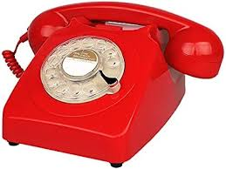
Why the focus on ICMP and Link Local?
ICMP is a critical service with IPv6!
  Legacy ICMP blocking to “hide” from ping of death and such… ?
Link-Local - “red phone” to your router and neighbors
  Link-Local IS a primary communication method

Slide 27
Neighbor Solicitation and Advertisements
Who is out there… [ east west via north south ]
A Client Solicitation ( typical ):
  Neighbor Solicitation sent via ICMPv6 (Type135) from
  Source: Unicast IPv6 Address to
  Destination: Solicited Node Multicast address of all routers ( ff02::1 )
Info asked for: What is your link-layer address? Answer provided with data given of target link-layer address

Slide 28
Neighbor Solicitation and Advertisements
The Answer via Advertisement:
A Client Advertisement ( typical ):
  All nodes reply sending Node Advertisement to the Solicit message ICMPv6 (type 136)
  Source: Unicast IPv6 Address
  Destination: unicast address of requestor -or - all nodes multicast ( ff02::1 )
Answer: Here is my IPv6 and my Link-layer address ( fe80 )

Slide 29
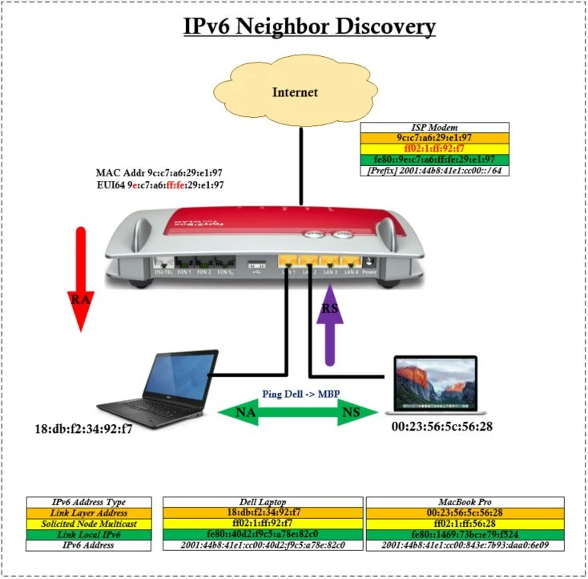
RA - Router Advertisement
RS - Router Solicitation
NA - Neighbor Advertisement
NS - Neighbor Solicitation

Slide 30
Example of Neighbors from client.
root@gort:~# ip -6 neigh show
fe80::5054:ff:fee2:6fe dev enp3s0 lladdr 52:54:00:e2:06:fe REACHABLE
2602:43:649:a00::1 dev enp3s0 lladdr 40:8d:5c:f9:68:88 router REACHABLE
2602:43:649:a00::53 dev enp3s0 lladdr 52:54:00:e2:06:fe STALE
fe80::428d:5cff:fef9:6888 dev enp3s0 lladdr 40:8d:5c:f9:68:88 router REACHABLE

Slide 31
Fundamentals that underpin IPv6 - Client
Router Advertisement ( RA )
A Router Advertisement:
Is every 200 seconds
  configurable and able to be ‘asked for’ by clients
Data about how to join the network
  Lifetime
  Reachable Time
  MTU, Retransmission, etc…
Flags are the “Flavor” of the network ( DHCP / SLAAC / Mixed use, etc… )
  Managed Address Configuration ( M )
  Other Stateful Configuration ( O )
  Address Autoconfiguration ( A )
  On-Link (L )

Slide 32
Fundamentals that underpin IPv6 - Client
Router Advertisement ( RA ) - FLAGS
Router Advertisement Flags - How do you want your clients to ask?
  Managed Address Configuration (M)
    DHCPv6 ( 1 = yes)
  Other Stateful Configuration (O)
    Use DHCPv6 for more info ( 1 = yes )
  Address Autoconfiguration (A) = SLAAC ( 0 = no )
  On-Link (L) = Topology
    0 = talk with the router for details
    1 = neighbors are on same ‘link’ )

Slide 33
SLAAC with RDNSS RA via tcpdump
TCPDUMP of a ROUTER SOLICIT ( ICMPv6 type 134 ) message:
grobb3@tars:~$ sudo tcpdump -i br0 "icmp6 && ip6[40] == 134" -vv
10:39:03.025724 IP6 (hlim 255, next-header ICMPv6 (58) payload length: 168) fe80::428d:5cff:fef9:6889 > ip6-allnodes: [icmp6 sum ok] ICMP6, router advertisement, length 168
hop limit 64, Flags [managed, other stateful], pref medium, router lifetime 1800s, reachable time 0ms, retrans timer 0ms
prefix info option (3), length 32 (4): 2602:43:62f:5300::/64, Flags [onlink, auto], valid time 86400s, pref. time 14400s
route info option (24), length 24 (3): ::/0, pref=medium, lifetime=1800s
rdnss option (25), length 56 (7): lifetime 1800s, addr: pi.hole addr: 2602:43:62f:5300::53 addr: _gateway
dnssl option (31), length 24 (3): lifetime 1800s, domain(s): robbs.casa.
source link-address option (1), length 8 (1): 40:8d:5c:f9:68:89
A IPv6 packet is 40 bytes long, and the first 8 bits of the ICMPv6 header specify its type
Notes:
RDNSS allows routers to inform IPv6 hosts about available DNS Recursive Server Addresses and a DNS Search List

Slide 34
Fundamentals that underpin IPv6 - Client
Router Solicitation ( RS )
Client Ask: Dearest all IPv6 routers ( ff02::2) on this segment tell me about the global-unicast prefix via link-local.
NOTE: Only the router will reply all other nodes discard in that they do not answer RS requests.
Router Answer: I heard an ask about the global-unicast on my link-local. Via my link-local dearest all nodes (ff02::1 ) global-unicast has the following prefix ( 2001:db8:000a:000e:: ) with with length of /64.

Slide 35
Fundamentals that underpin IPv6 - Client
How to get a client IPv6 IP Address… ( a client point of view )
Link-Local - cool we are done… fe80 + EUI-64
Manual Stateful assignment
  Humans…
  And, we already have a Link-Local
SLAAC
  Stateless Address Auto-configuration
  ( No DNS hand-off ratified to RFC ‘yet’.. )
  there is RDNSS :-D
  DAD
DHCPv6
  Vendor options - <3 ( I’m biased http boot etc… ) <3
  DAD
  ISC - Kea <-> Stork

Slide 36
Fundamentals that underpin IPv6 - Client (Manual Method)
1) Talk with a network administrator
2) Be assigned an address and gateway ( DNS too )
3) Apply to your hardware in the usual method.
Error prone, time consuming, was that an echo-niner?
We already have link-local for ‘free’.

Slide 37
Fundamentals that underpin IPv6 - Client
(SLAAC )
Node configuration via link-local address
( local prefix + EUI-64 identification from MAC from process above )
DAD - Duplicate Address Detection
Solicited-node multicast ( ff02:1::<last 6 hex>)
Node sends Router Solicitation via link local ( ff02::2 - all routers) router hands back to source via ( ff02:1 - all nodes )
Node configures Global Address and fires of DAD again in addition to a Neighbor Solicitation ( ICMPv6 )
Uhh where is my DNS ( if there is not a RDNSS reply).
Can be fast and you get to know your neighbors.
TL;DR - We're Up with global link.

Slide 38
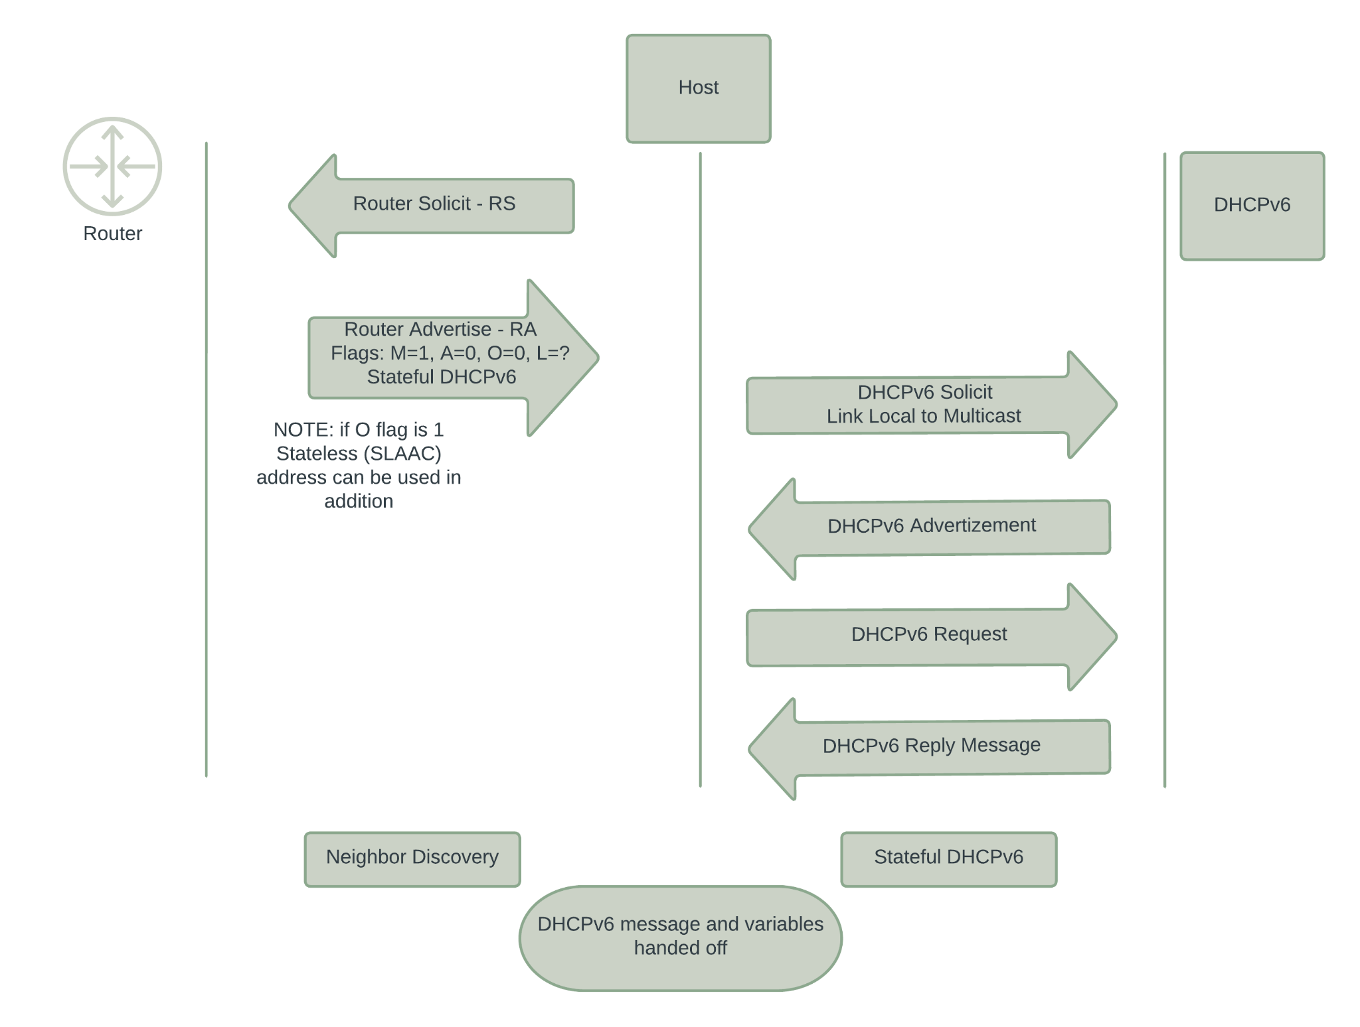
Fundamentals that underpin IPv6 - DHCPv6

Slide 39
Fundamentals that underpin IPv6 - DHCPv6
Listeners are UDP -
  Clients listen on port 546/UDP
  Servers and relays listen on port 547/UDP
DHCP unique identifier ( DUID )
  There currently four DUID types:
    DUID-LLT (Type 1): using Link-Layer address plus Time (32-bits, seconds since 01.01.2000 00:00 UTC modulo 2^32) ( MAC based )
    DUID-EN (Type 2): using vendor assigned Enterprise Number
    DUID-LL (Type 3): using Link-Layer address ( MAC based )
    DUID-UUID (Type 4): using a Universally Unique Identifier (UUID)
Prefix and address delegation does not need to be based on DUID!!
  RFC-6939 host reservation based on MAC ( isc-dhcp / kea )

Slide 40
Fundamentals that underpin IPv6 - DHCPv6
"reservations": [
{
"hw-address": "3c:18:a0:44:5e:4f",
"hostname": "burp.robbs.casa.",
"ip-addresses": [ "2001:db8:401:a000::00bb" ],
"option-data": [
{
"name": "dns-servers",
"data": "2001:db8:401:a000::53"
}
]
}

Slide 41
Fundamentals that underpin IPv6 - DHCPv6
"reservations": [
{
"duid": "00:01:00:01:24:a8:d2:b1:00:50:56:8d:19:d1",
"hostname": "burp.robbs.casa.",
"ip-addresses": [ "2001:db8:401:a000::00bb" ],
"option-data": [
{
"name": "dns-servers",
"data": "2001:db8:401:a000::53"
}
]
}

Slide 42
Fundamentals that underpin IPv6 - DHCPv6
Client reservations - DUID vs MAC
Up to personal preferences
DUIDs can be problematic to debug when OSes are cloned or multiple relays are involved.
MACs can be cloned or changed ( VMs and such )
Local segment DUIDs are elegant 4 types to use
The choice is up to what works best for you…

Slide 43
Fundamentals that underpin IPv6 - DHCPv6
Prefix Delegations - PD
Not practical to try to assign prefixes manually when working at scale in IPv6 space.
ISP hands off a /48 /56 /60 /64 (“depends” - recall ARIN guidance )
Your local network can now allocate out of this prefix to clients.

Slide 44
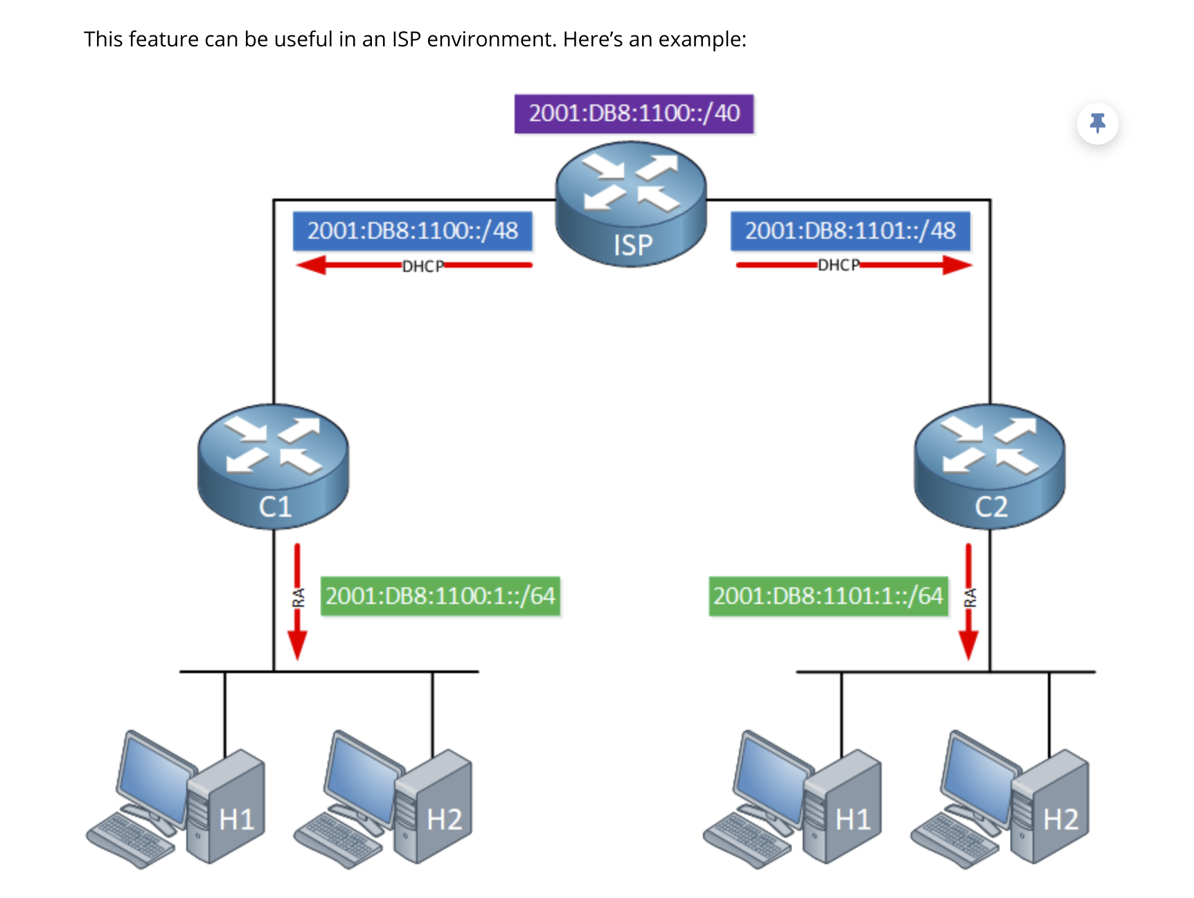

Slide 45
That was a just a bit…
Questions and Discussion?

