Slide 1




Hands-on Workshop on Network Technologies
Hands-on session 2: Local Preference and MED Attributes
Lab 8.1 - BGP Lab Series
Jose Gomez¹, Jorge Crichigno²
¹Fort Lewis College (FLC)
²University of South Carolina (USC)
https://research.cec.sc.edu/cyberinfra/
Tuesday, Jul 28, 2026
Online

Slide 2
Lab Series: Border Gateway Protocol
Lab experiments
  Lab 1: Introduction to Mininet
  Lab 2: Introduction to Free Range Routing (FRR)
  Lab 3: Introduction to BGP
  Lab 4: Configure and verify EBGP
  Lab 5: BGP Authentication
  Lab 6: Configure BGP with Default Route
  Lab 7: Using AS_PATH BGP Attribute
  Lab 8: Configuring IBGP and EBGP Sessions, Local Preference, and MED
  Lab 8.1: Configuring OSPF, IBGP and EBGP Sessions, Local Preference, and MED
  Lab 9: IBGP, Next Hop and Full Mesh Topology
  Lab 10: BGP Route Reflection
  Lab 11: Configuring BGP Local Preference, and AS_PATH Prepending
  Lab 11.1: Configuring BGP Local Preference, and AS_PATH Prepending
  Lab 12: Hot Potato Routing and BGP LOCAL_PREF Attribute
  Lab 13: Configuring Local Preferences on a Per Route Basis

Slide 3
Organization of the labs
Each lab starts with a section Overview
  Objectives
  Lab topology
  Lab settings: passwords, device names
  Roadmap: organization of the lab
Section 1
  Background information of the topic being covered (e.g., fundamentals of BGP)
  Section 1 is optional (i.e., the reader can skip this section and move to lab directions)
Section 2… n
  Step-by-step directions

Slide 4
Local Preference and MED Attributes
Lab activities are described in Lab 8.1, BGP Lab Series

Slide 5
Hands-on Labs on BGP
Webpage with PowerPoint presentations:
https://research.cec.sc.edu/cyberinfra/NT_2026
Hands-on session 2 (3:15PM-3:55PM): to access labs for Session 2 (BGP LOCAL_PREF and MED Attributes).
The virtual platform (Netlab) is reachable through the following link:
https://netlab.cec.sc.edu

Slide 6
LOCAL_PREF Attribute
The LOCAL_PREF attribute is advertised among Internal BGP (IBGP) routers
It indicates the preferred path to external Autonomous Systems (ASes) when an AS has multiple routes to another AS
The BGP route with the highest LOCAL_PREF value is preferred

Slide 7
MED Attribute
The MED attribute indicates to external neighbors the preferred path into an AS
It is used when there are multiple entry points to the same AS
The BGP route with the lowest MED value is preferred

Slide 8
Lab Topology
Configure OSPF as IGP in AS 200
Configure BGP as EGP between AS 100 and AS 200

Slide 9
Lab Topology
Configure LOCAL_PREF and MED attributes to favor the primary link over the secondary one
Primary link
Secondary link

Slide 10
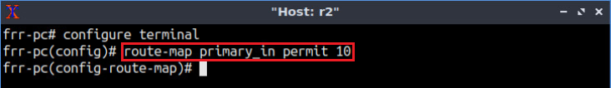
Lab Configuration
Create a route map to set the LOCAL_PREF attribute of the primary link
Router r2
Primary link

Slide 11
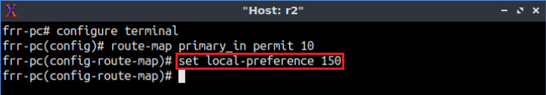
Lab Configuration
Set the LOCAL_PREF value of the primary link to 150
Router r2
Primary link

Slide 12
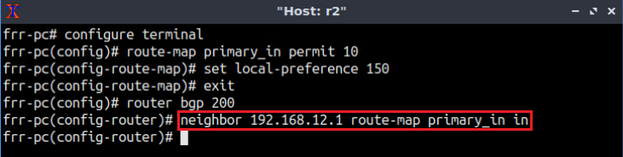
Lab Configuration
Assign the route-map to the BGP neighbor (router r1)
Router r2
Primary link
Router r1

Slide 13
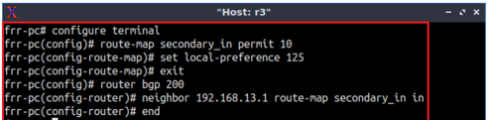
Lab Configuration
Similarly, configure LOCAL_PREF on router r3 for the secondary link
Router r1
Router r3
Secondary link

Slide 14
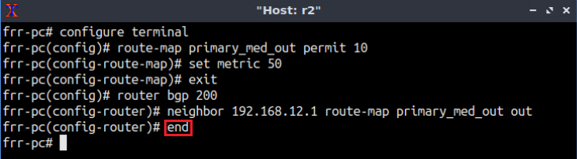
Lab Configuration
Similarly, configure MED on router r2
Router r2
Primary link
Router r1

Slide 15
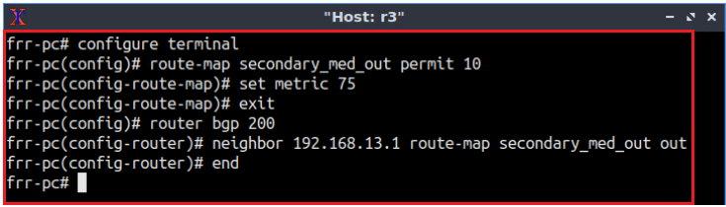
Lab Configuration
Similarly, configure MED on router r3
Router r1
Router r3
Secondary link

Slide 16
Additional Slides

Slide 17
Lab Topology

Slide 18
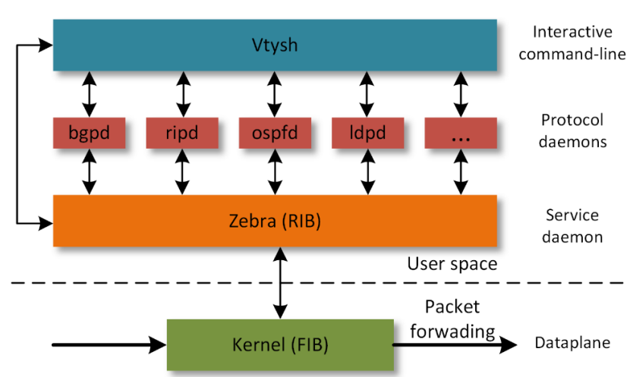
Free Range Routing (FRR) Architecture (Lab 2)

