Slide 1




Hands-on Workshop on Network Technologies
Hands-on session 1: Essentials of BGP, EBGP, IBGP
Lab 3 - BGP Lab Series
Jose Gomez¹, Jorge Crichigno²
¹Fort Lewis College (FLC)
²University of South Carolina (USC)
https://research.cec.sc.edu/cyberinfra/
Tuesday, Jul 28, 2026
Online

Slide 2
Lab Series: Border Gateway Protocol
Lab experiments
  Lab 1: Introduction to Mininet
  Lab 2: Introduction to Free Range Routing (FRR)
  Lab 3: Introduction to BGP
  Lab 4: Configure and verify EBGP
  Lab 5: BGP Authentication
  Lab 6: Configure BGP with Default Route
  Lab 7: Using AS_PATH BGP Attribute
  Lab 8: Configuring IBGP and EBGP Sessions, Local Preference, and MED
  Lab 8.1: Configuring OSPF, IBGP and EBGP Sessions, Local Preference, and MED
  Lab 9: IBGP, Next Hop and Full Mesh Topology
  Lab 10: BGP Route Reflection
  Lab 11: Configuring BGP Local Preference, and AS_PATH Prepending
  Lab 11.1: Configuring BGP Local Preference, and AS_PATH Prepending
  Lab 12: Hot Potato Routing and BGP LOCAL_PREF Attribute
  Lab 13: Configuring Local Preferences on a Per Route Basis

Slide 3
Organization of the labs
Each lab starts with a section Overview
  Objectives
  Lab topology
  Lab settings: passwords, device names
  Roadmap: organization of the lab
Section 1
  Background information of the topic being covered (e.g., fundamentals of BGP)
  Section 1 is optional (i.e., the reader can skip this section and move to lab directions)
Section 2… n
  Step-by-step directions

Slide 4
Introduction to BGP
Lab activities are described in Lab 3, BGP Lab Series

Slide 5
Hands-on Labs on BGP
Webpage with PowerPoint presentations:
https://research.cec.sc.edu/cyberinfra/NT_2026
Hands-on session 1 (1:40PM-2:10PM): to access labs for Session 1 (Essentials of BGP, EBGP, IBGP).
The virtual platform (Netlab) is reachable through the following link:
https://netlab.cec.sc.edu

Slide 6
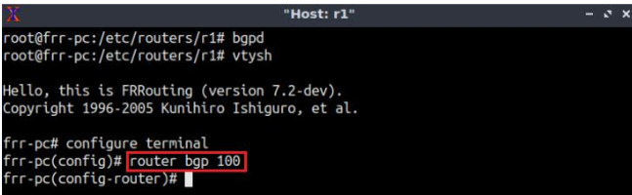
Lab Topology
Enable the BGP process
Router r1

Slide 7
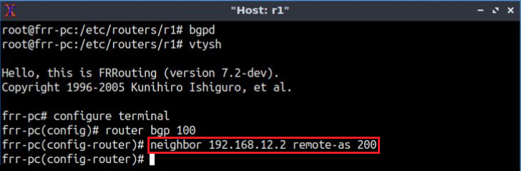
Lab Topology
Establish BGP neighborhood
Router r1

Slide 8
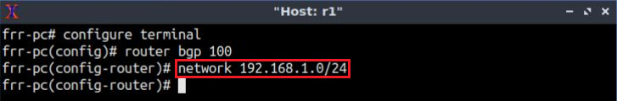
Lab Topology
Advertise a network in BGP
Router r1

Slide 9
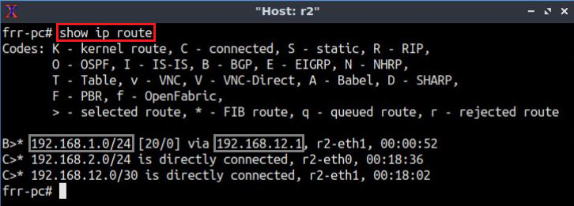
Lab Topology
Routing table: lists the routes learned from different routing protocols
Router r2

Slide 10
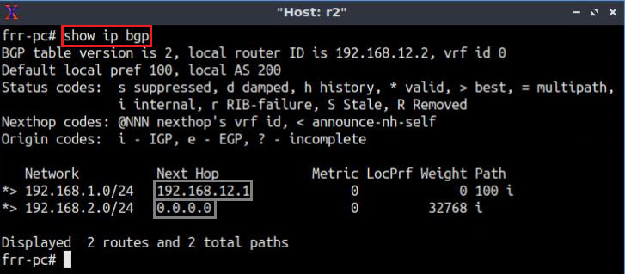
Lab Topology
BGP table: lists the routes learned from BGP routing protocol
Router r2

Slide 11
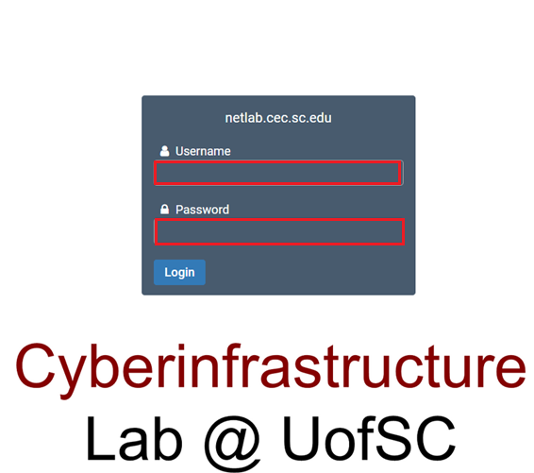
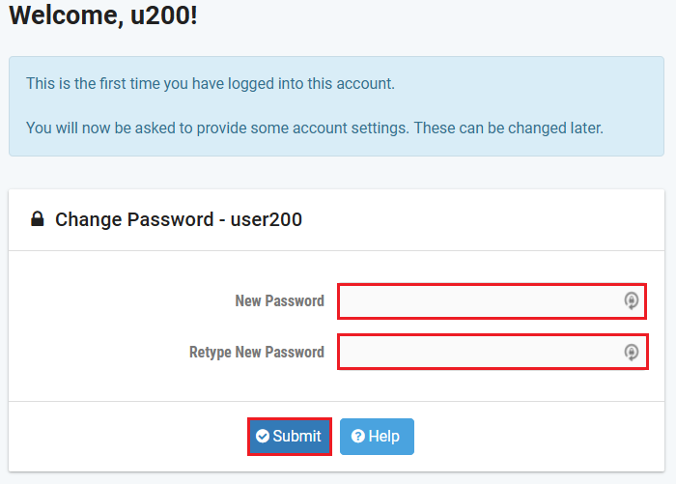
Accessing the Platform
Please use the following link to access the platform:
  https://netlab.cec.sc.edu/
Login using your credentials
Username: <email address used for the registration>
Temporary Password: nsf-2026

Slide 12
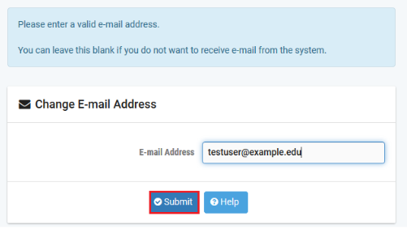
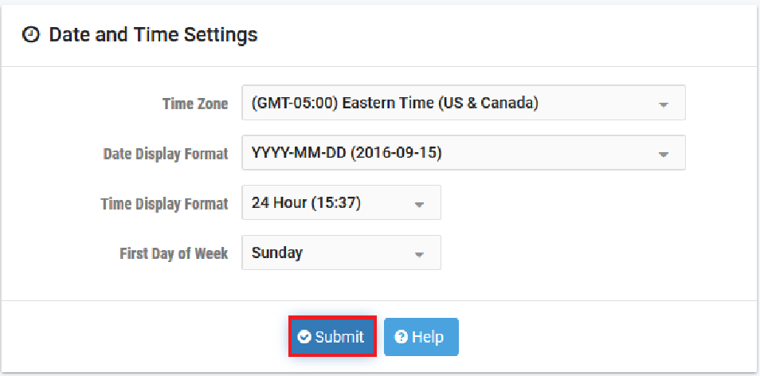
Accessing the Platform
Please use the following link to access the platform:
  https://netlab.cec.sc.edu/
Login using your credentials
Username: <email address used for the registration>
Temporary Password: nsf-2026

Slide 13
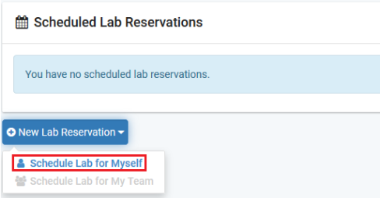
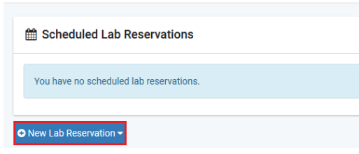
Accessing the Platform
Click on New Lab Reservation
Click on Schedule Lab for Myself

Slide 14
Accessing the Platform
Select the course
For this session, we will use “BGP Lab Series”

Slide 15
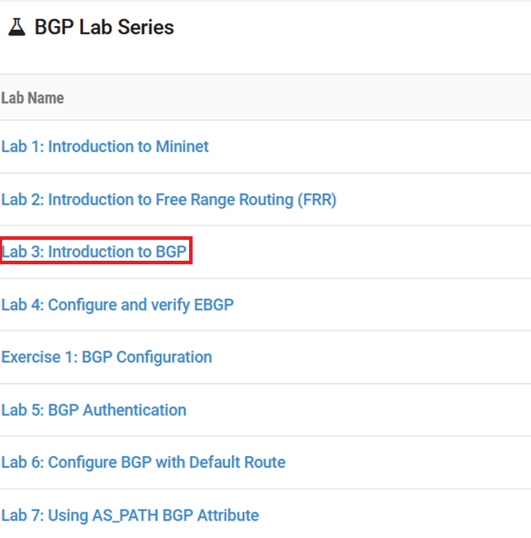
Accessing the Platform
Select the Lab
For this session, we will run:
  Lab 3: Introduction to BGP

Slide 16
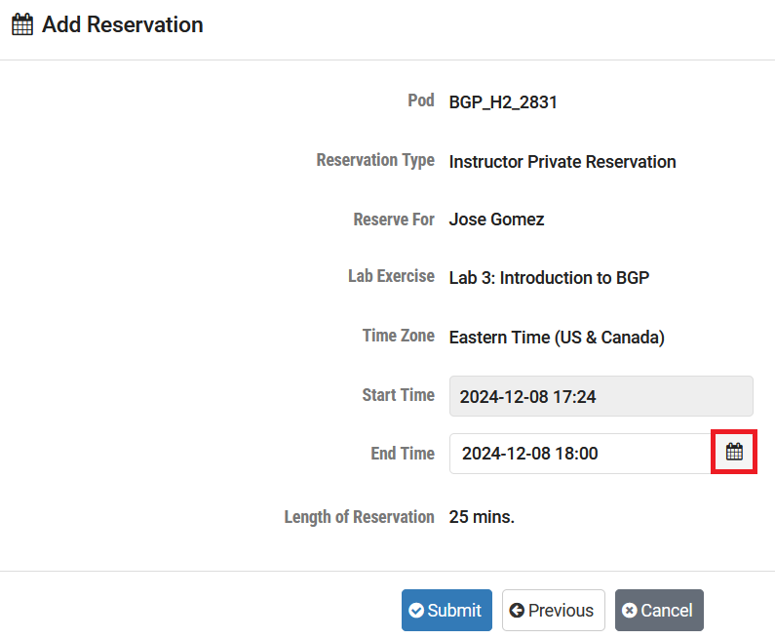
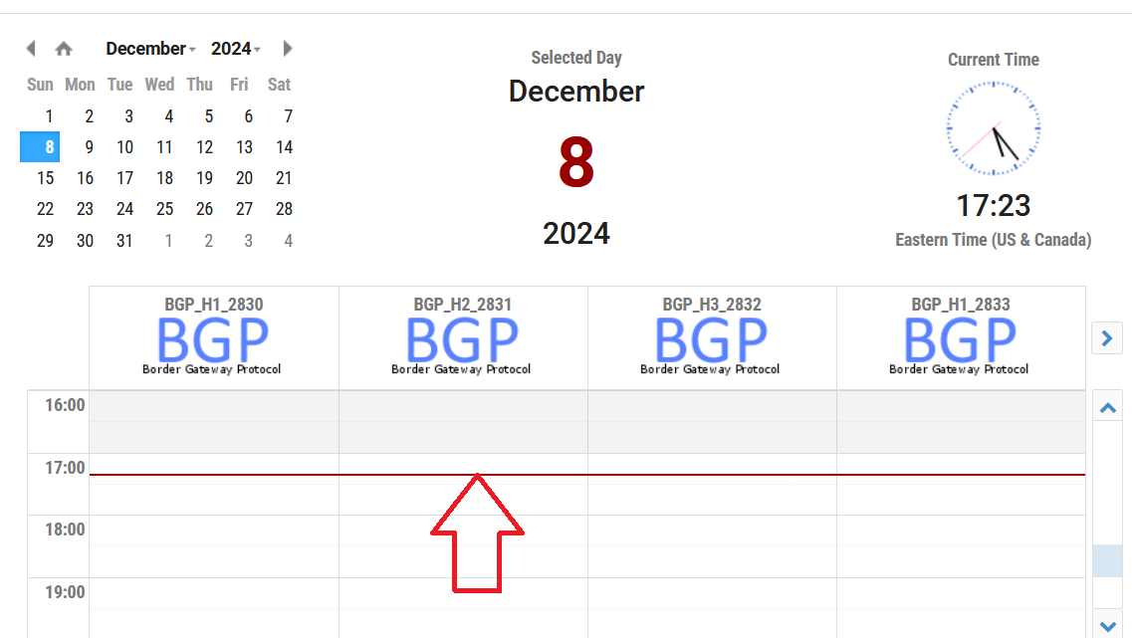
Accessing the Platform
Select the next available POD and allocate time

Slide 17
Accessing the Platform
We will use the NETLAB virtual platform:
URL: https://netlab.cec.sc.edu/
Username: <email address used for the registration>
Temporary Password: nsf-2026

Slide 18
Additional Slides

Slide 19
Lab Topology

Slide 20
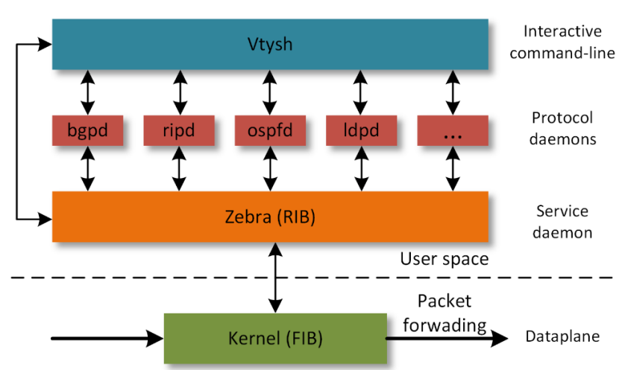
Free Range Routing (FRR) Architecture (Lab 2)

